Slide 1
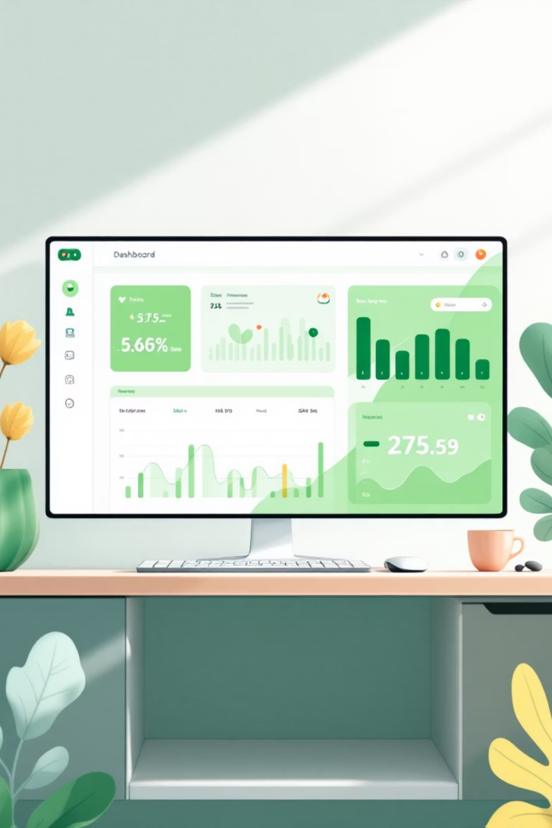
Customer Revenue & Product Performance Optimization
SQL-Based Business Analysis for an E-Commerce Company

Slide 2
Executive Summary
This project analyzed over 3,000 sales records to identify key revenue drivers and customer behavior patterns for an e-commerce business. Leveraging MySQL and advanced SQL techniques, we distilled critical insights into product performance, customer loyalty, and discount effectiveness.
Concentrated Revenue
Customer Loyalty
Revenue is highly concentrated within a few core product categories and products.
Repeat customers and higher loyalty tiers drive a disproportionate share of total revenue.
Discount Impact
Strategic Optimization
Discounts increase purchase volume, but their revenue impact varies significantly by region.
Insights enable data-driven decisions in product focus, pricing, marketing, and retention.

Slide 3
Project Overview
Unlocking Revenue Growth Through Data
An e-commerce company faced uneven revenue growth across regions and unclear customer loyalty performance. Management needed actionable insights on product performance, discount effectiveness, and customer behavior.
01
Data Cleaning
Standardized formats and removed orphan records
02
Domain: E-Commerce / Retail Analytics
SQL Analysis
Data Size: ~3,000 sales records across 3 relational tables
Advanced queries with joins and window functions
03
Insights
Actionable recommendations for growth

Slide 4


Business Questions Explored
Revenue Analysis
Total revenue, category performance, regional variations, and payment method trends
Customer Behavior
Loyalty tier impact, repeat purchase patterns, and high-value customer identification
Discount Effectiveness
Discounted vs non-discounted revenue, regional response, and quantity impact
Product Performance
Top performers, supplier contribution, new vs existing products, regional variations

Slide 5
Advanced SQL Techniques Deployed
1
2
Multi-Table Joins
Window Functions
Connected sales, customer, and product tables with proper foreign key relationships
Used RANK, ROW_NUMBER, and SUM OVER for advanced analytics
3
4
Conditional Logic
Reusable Views
Applied CASE WHEN statements for complex business rules
Created analytics views for ongoing business monitoring

Slide 6
Revenue Performance Snapshot
₹261K
3,000+
Top 20%
Total Revenue
Sales Records
Revenue Concentration
Generated across all categories and regions
Analyzed for comprehensive insights
Small set of products drives majority of revenue
Cleaning products contribute the highest revenue share, while Personal Care underperforms. Revenue distribution follows the Pareto principle with concentrated performance.

Slide 7

Customer Loyalty Drives Revenue
Key Findings
Higher Tiers = Higher Value
Customers in elevated loyalty tiers generate significantly more revenue per customer
Repeat Customers Matter
A large share of total revenue comes from customers placing multiple orders
Data Gaps Exist
Missing loyalty tier information limits deeper customer segmentation analysis

Slide 8




The Discount Dilemma
Higher Quantity
Lower Margins
Regional Variance
Discounts drive increased purchase volume per order
Revenue per order doesn't always increase proportionally
Discount effectiveness varies significantly by region
Strategic Implication: Use discounts selectively for volume-driven goals. Avoid blanket discounts—apply them to specific products or customer segments. Track both revenue and profitability when evaluating discount campaigns.

Slide 9




Product & Supplier Performance
Performance Patterns
1
Top Performers
Small number of products generate above-average revenue
2
Above Average
Older products outperform newer launches
3
Average Products
Regional performance varies dramatically
4
Underperformers
Few suppliers drive majority of revenue

Slide 10
Strategic Recommendations
1
Strengthen Loyalty Programs
Implement retention strategies and incentivize tier upgrades. High-tier customers generate disproportionate value.
2
Optimize Discount Strategy
Apply region-specific, targeted discounts. Focus on volume goals while protecting margins.
3
Prioritize Top Products
Increase visibility and stock for high performers. Review or discontinue consistent underperformers.
4
Boost New Product Adoption
Bundle new products with popular items. Increase targeted promotions for recent launches.
5
Reduce Cancellations
Improve fulfillment processes and optimize payment methods with high cancellation rates.
6
Leverage Seasonality
Align campaigns with high-performing months. Prepare inventory ahead of peak periods using historical trends.

Slide 11

Project Impact & Conclusion
Demonstrated Capabilities
This project showcases how advanced SQL analysis transforms raw transactional data into strategic business intelligence.
Solved real-world e-commerce challenges using MySQL
Uncovered revenue drivers and customer behavior patterns
Delivered actionable insights for sales, marketing, and product teams
Created reusable analytics views for ongoing monitoring
"SQL-powered analytics enabled data-driven decision-making across revenue optimization, customer retention, and product strategy."

